Slide 1
RAFT - Distributed consensus protocol

Slide 2
Distributed = Many
Consensus = Agreement

Slide 3
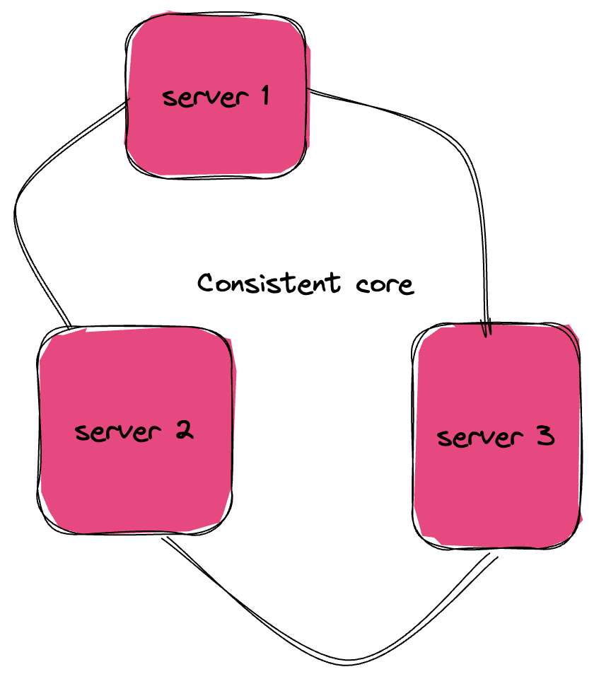
Consistent core

Slide 4
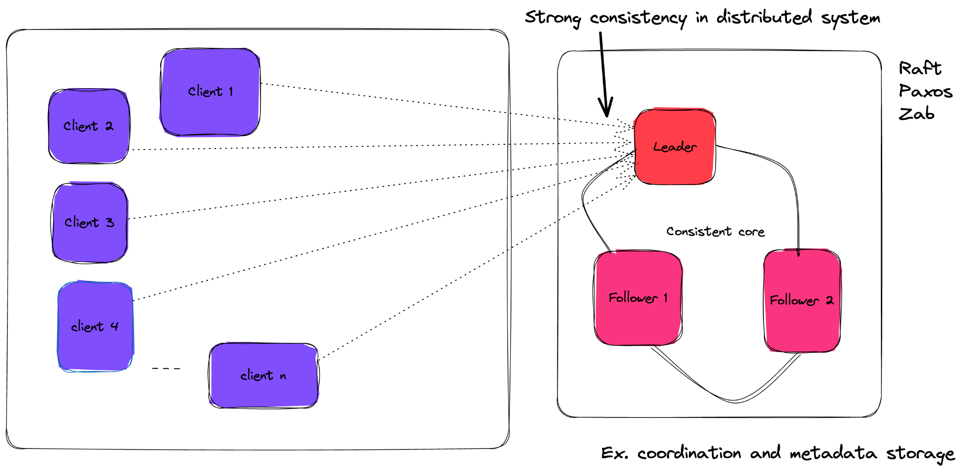
Linearizability

Slide 5
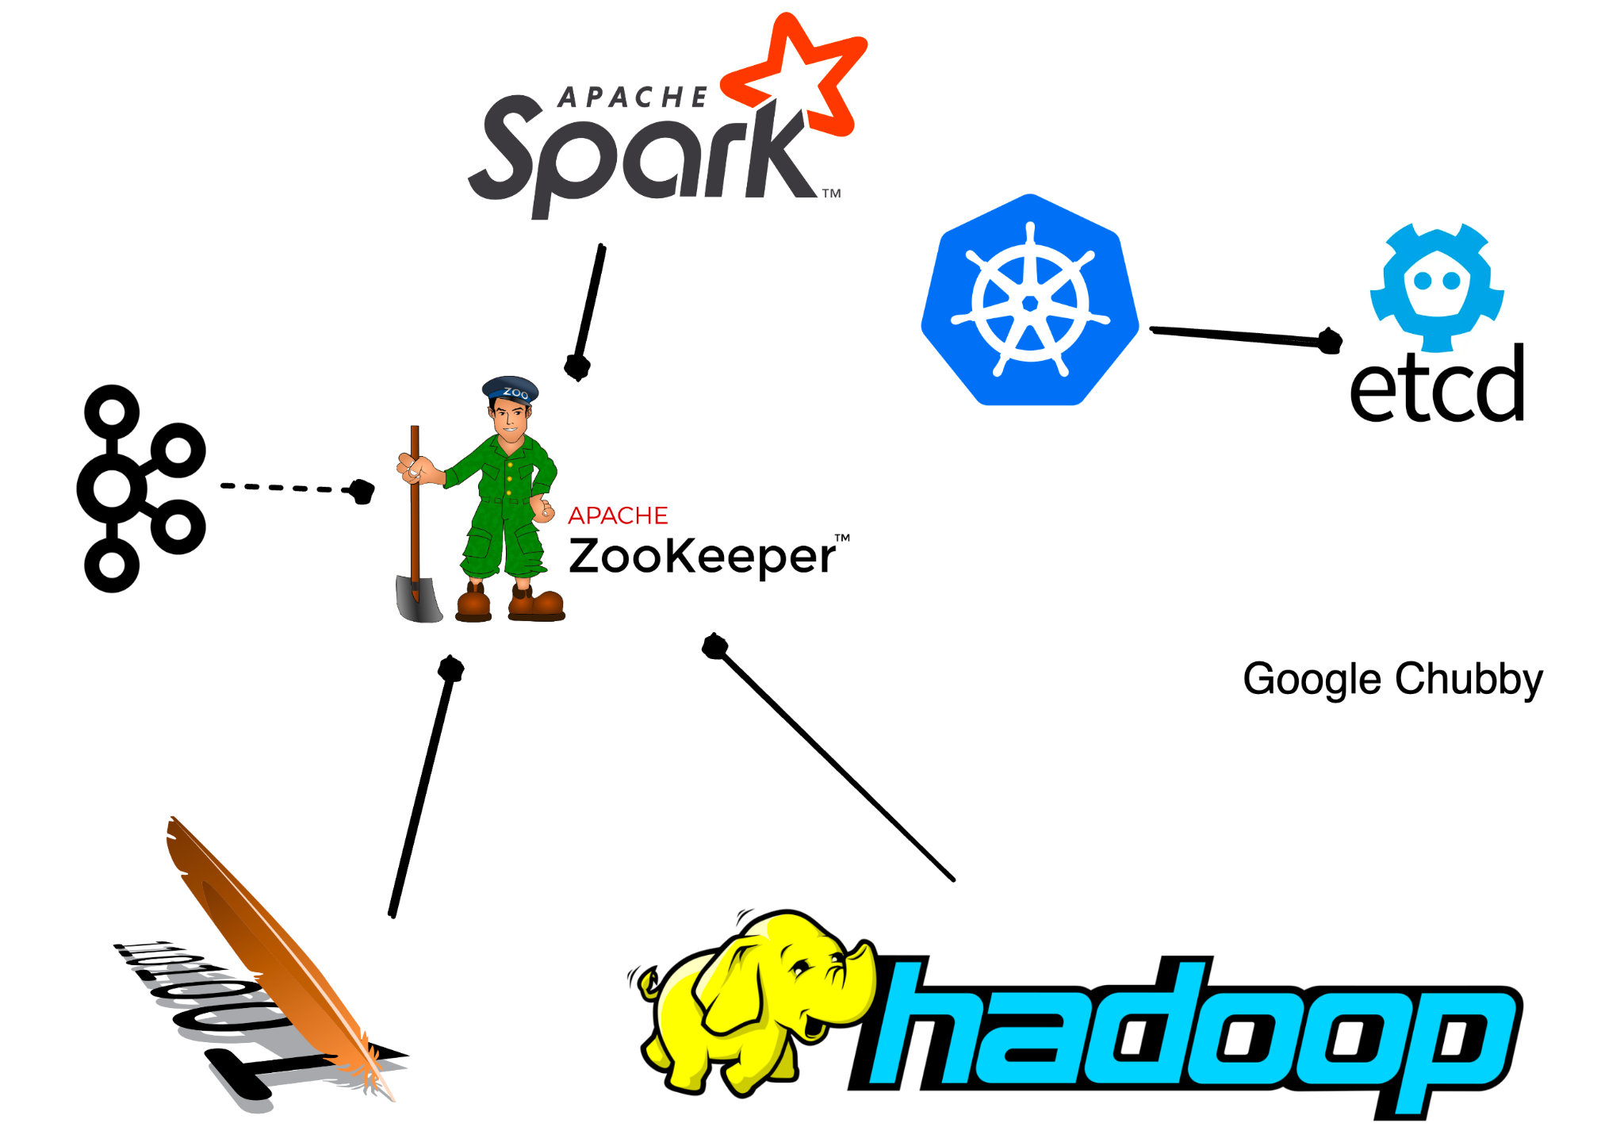
Examples

Slide 6
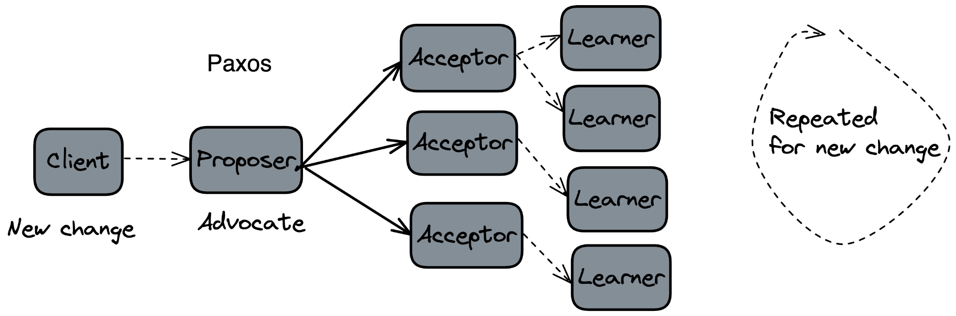
Paxos
Notes:
Many state and many participants Complex and tricky implementation
Not easy to understand.

Slide 7

Roles in Raft
It has 3 roles
Leader
Follower
Candidate

Slide 8
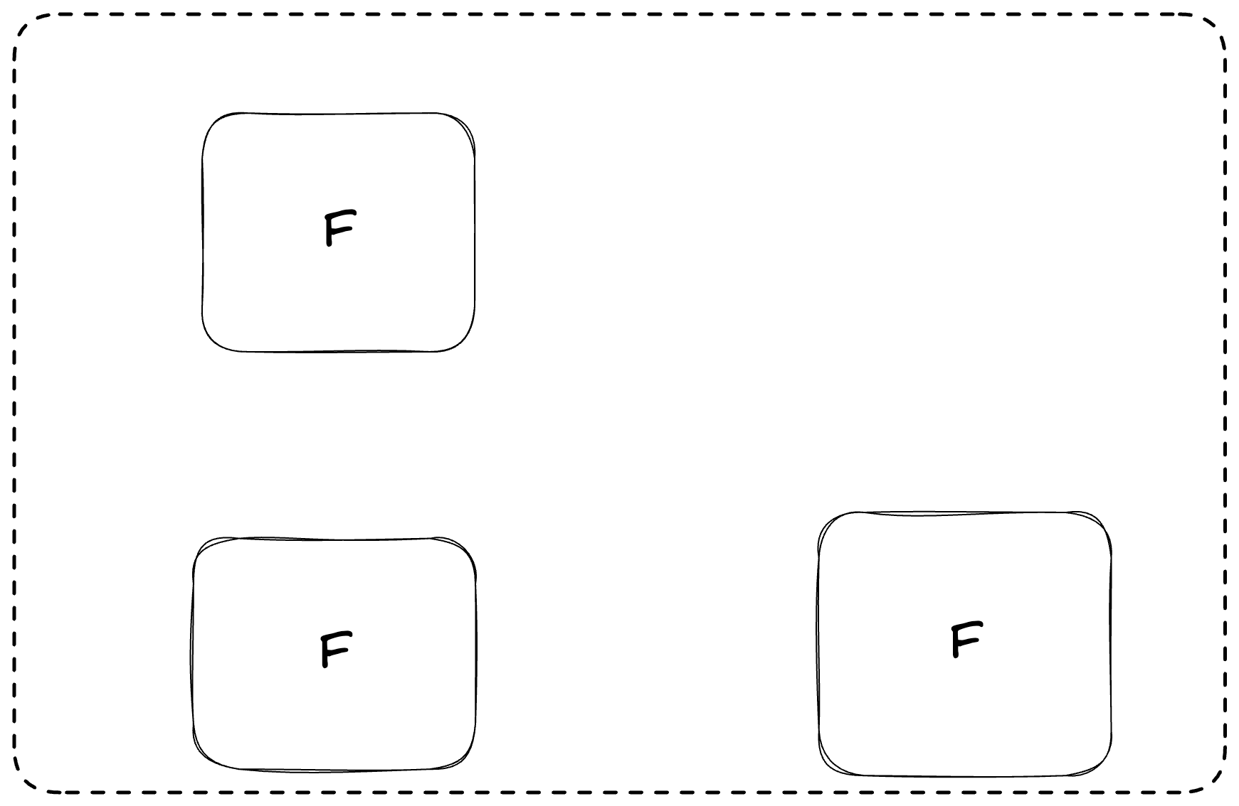
Example

Slide 9
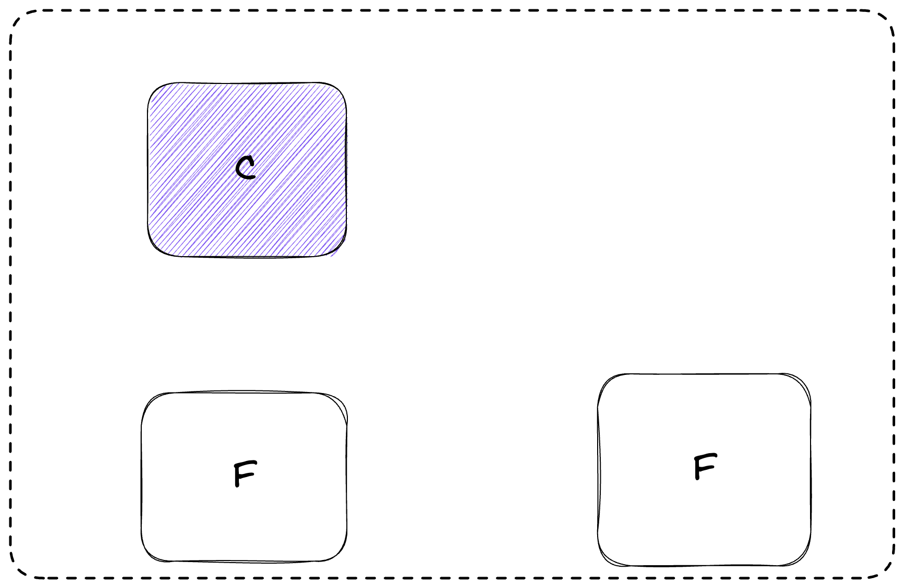

Slide 10
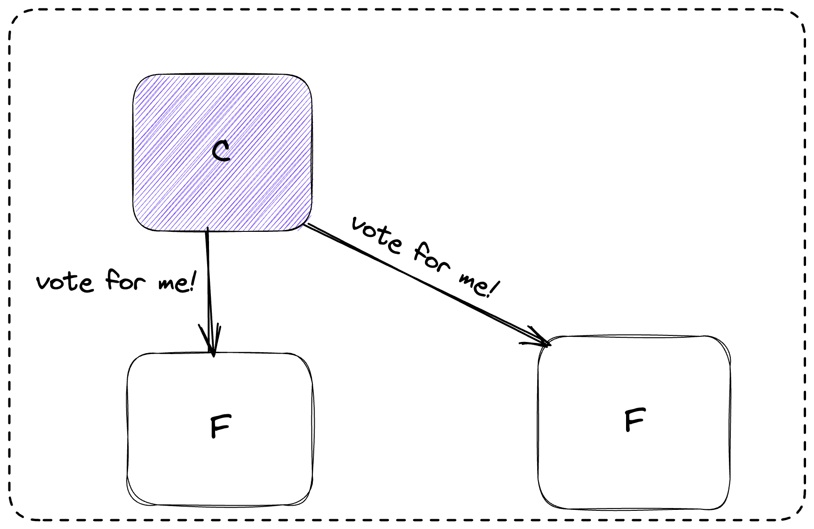

Slide 11
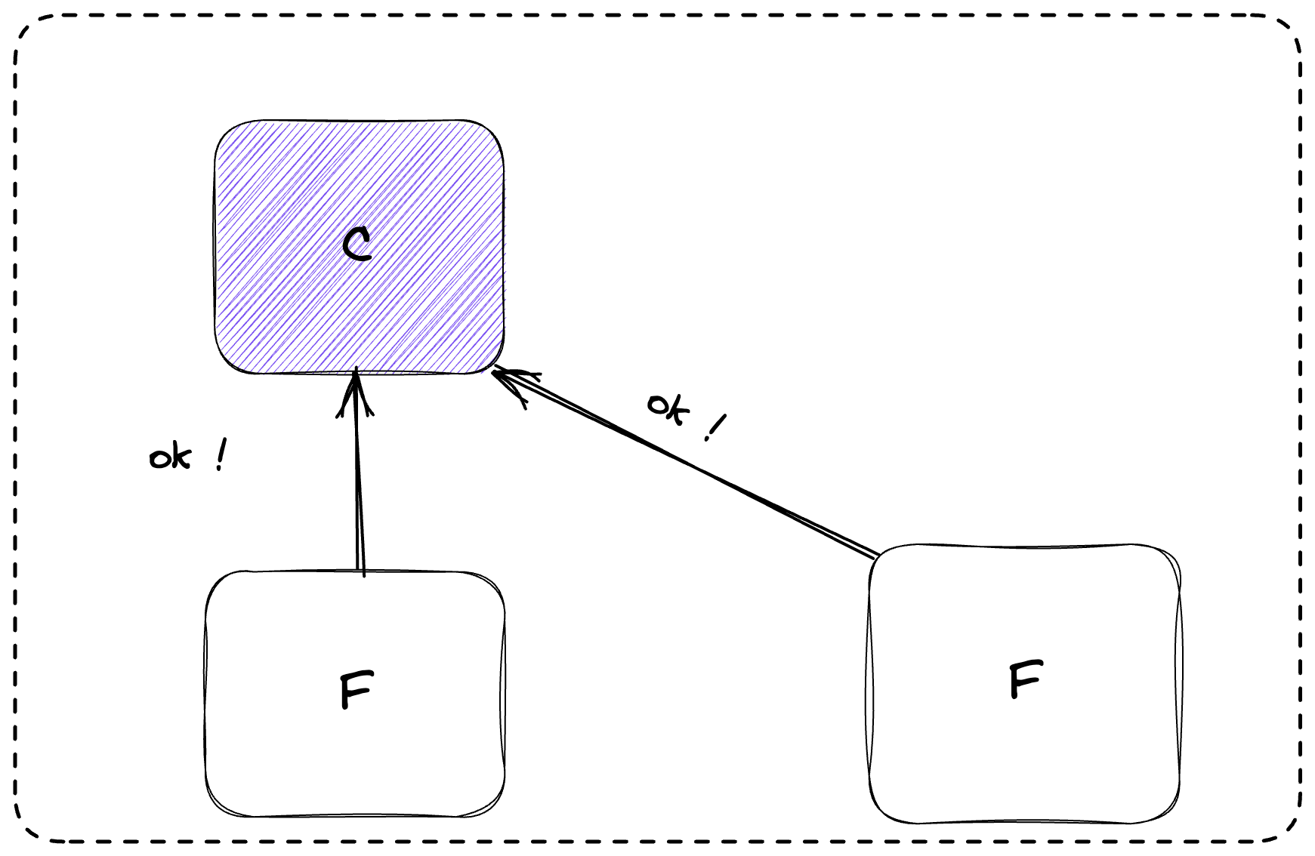

Slide 12
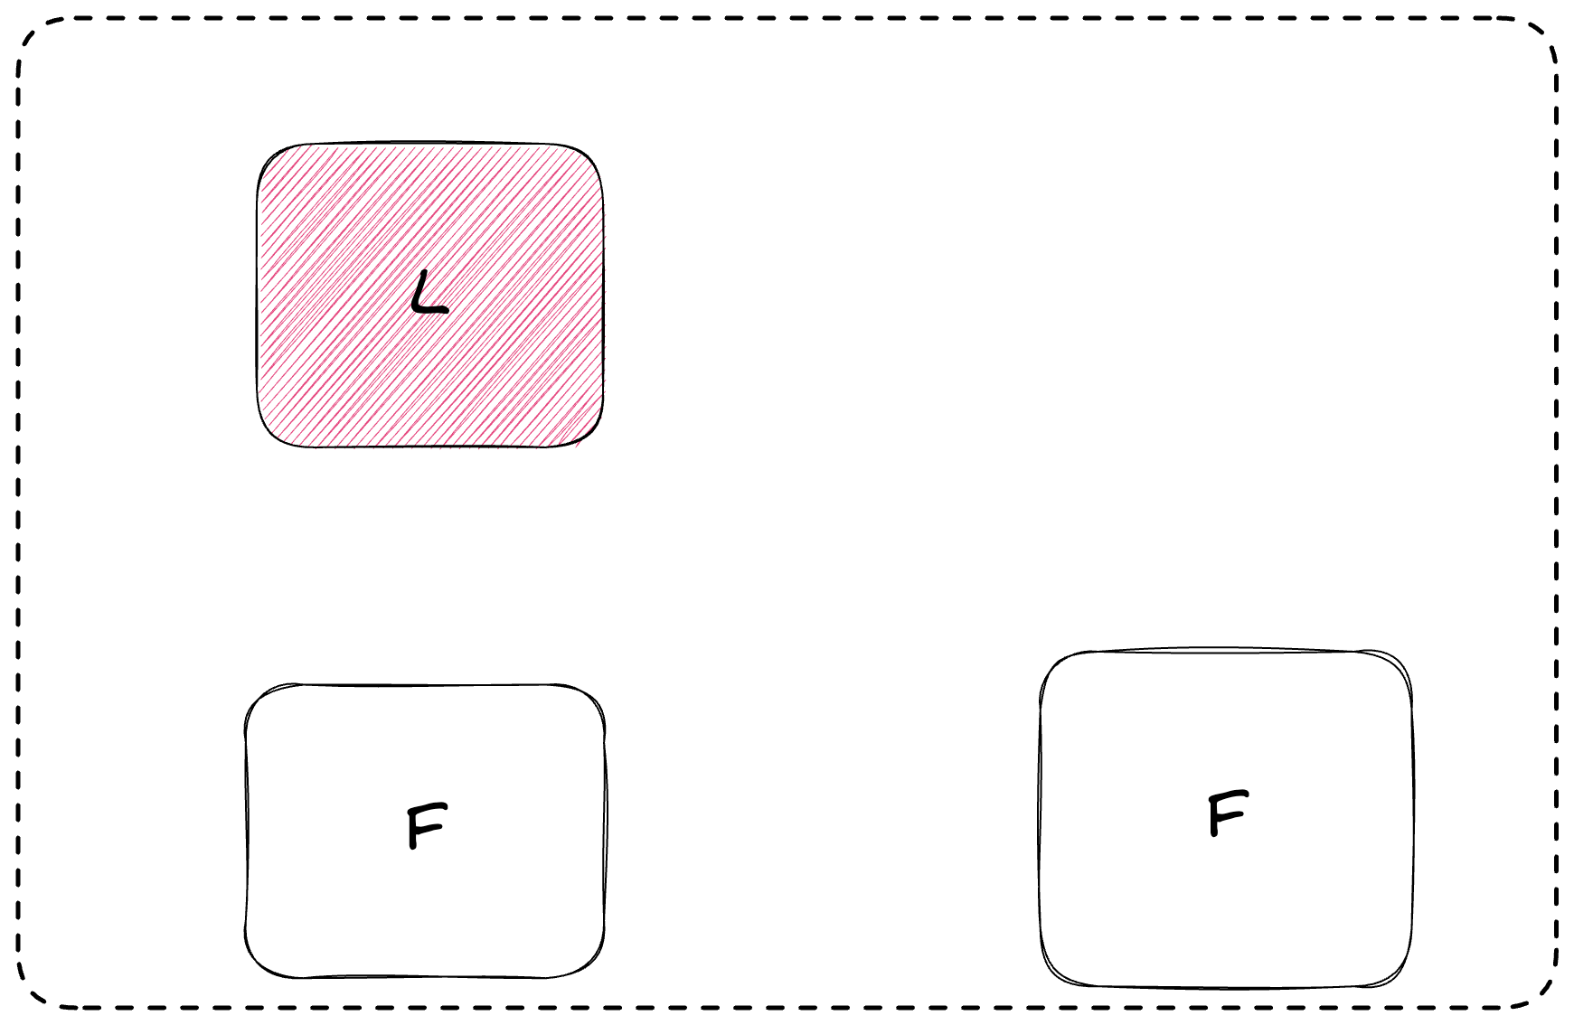

Slide 13
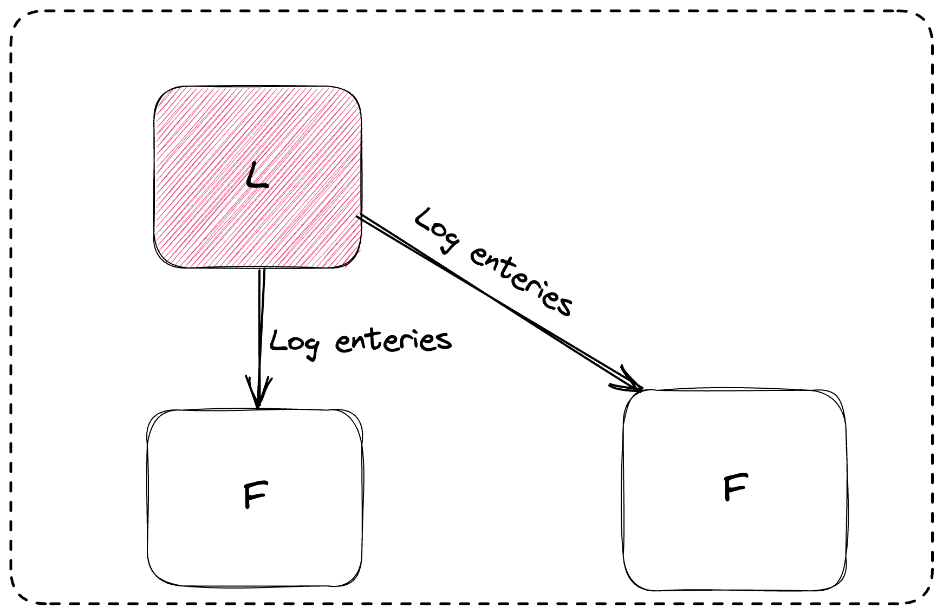

Slide 14
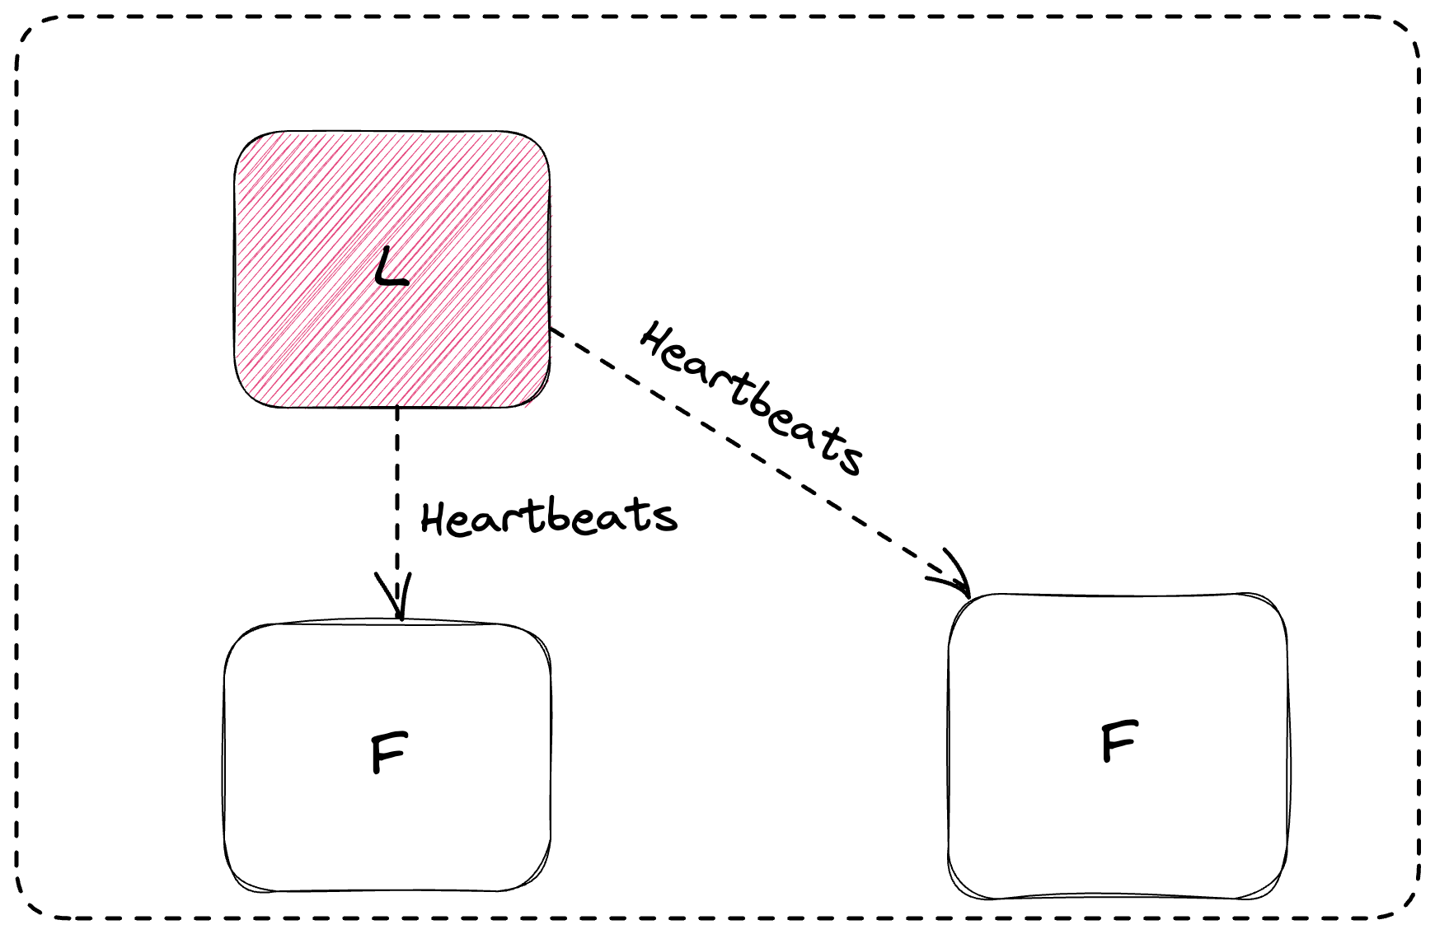

Slide 15
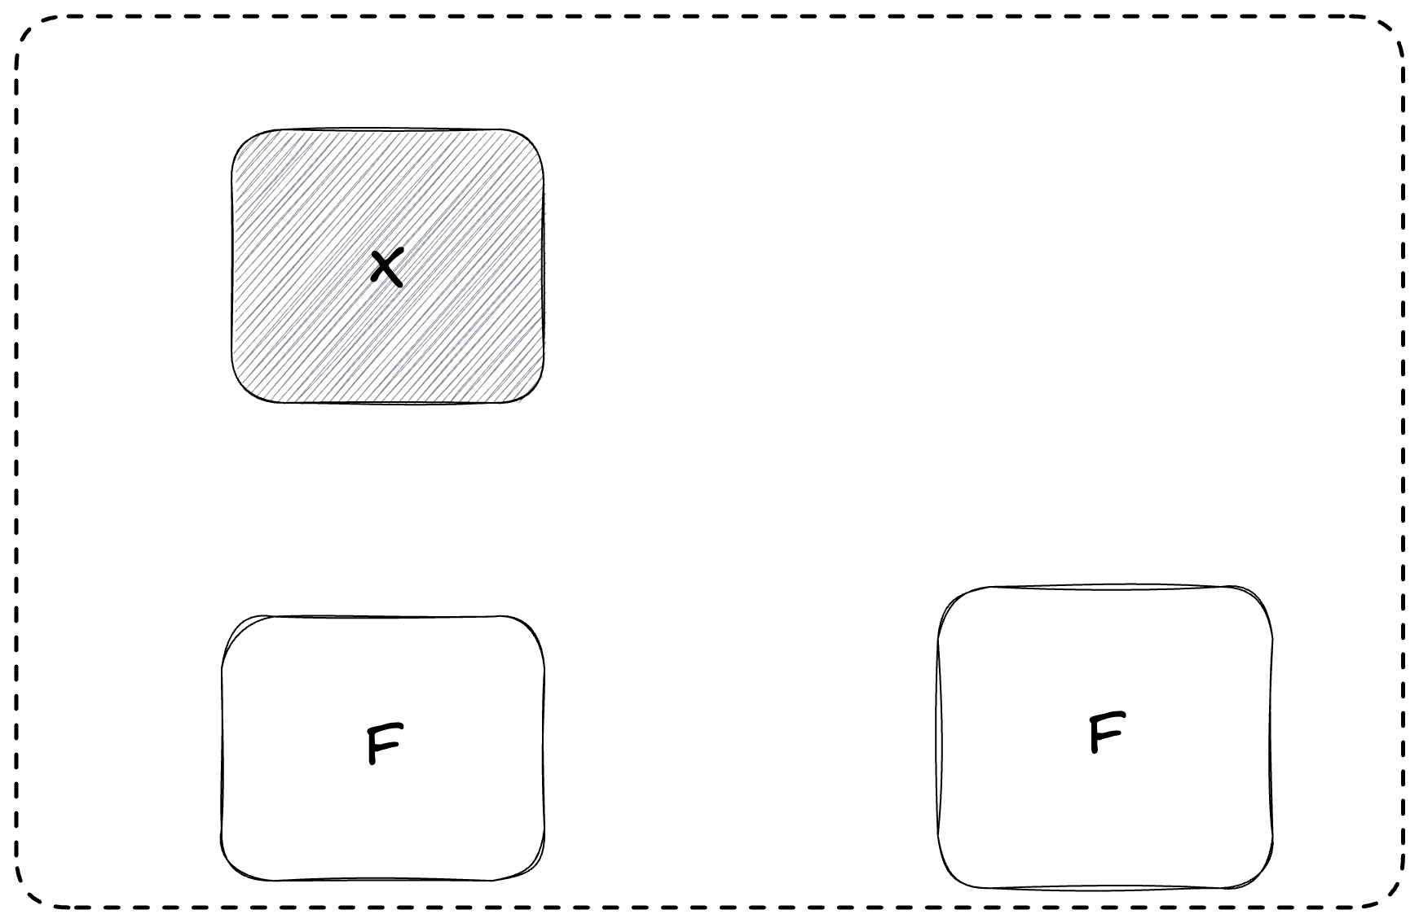

Slide 16
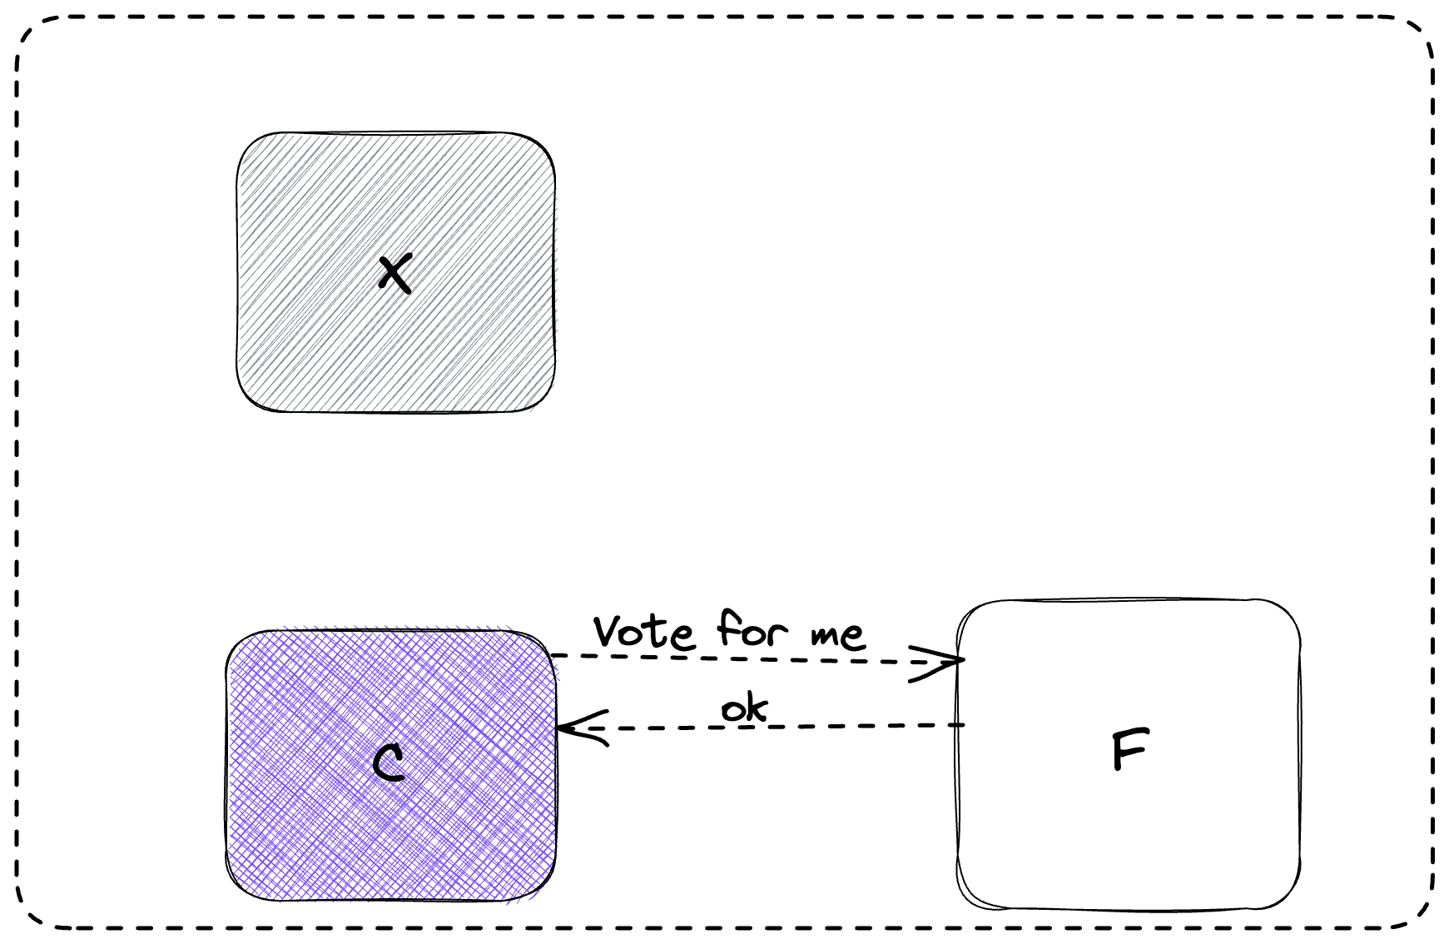

Slide 17
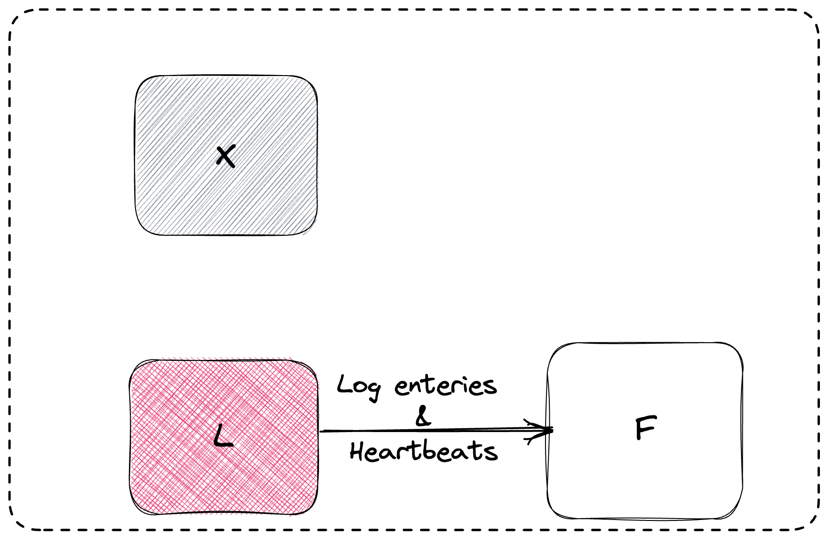

Slide 18
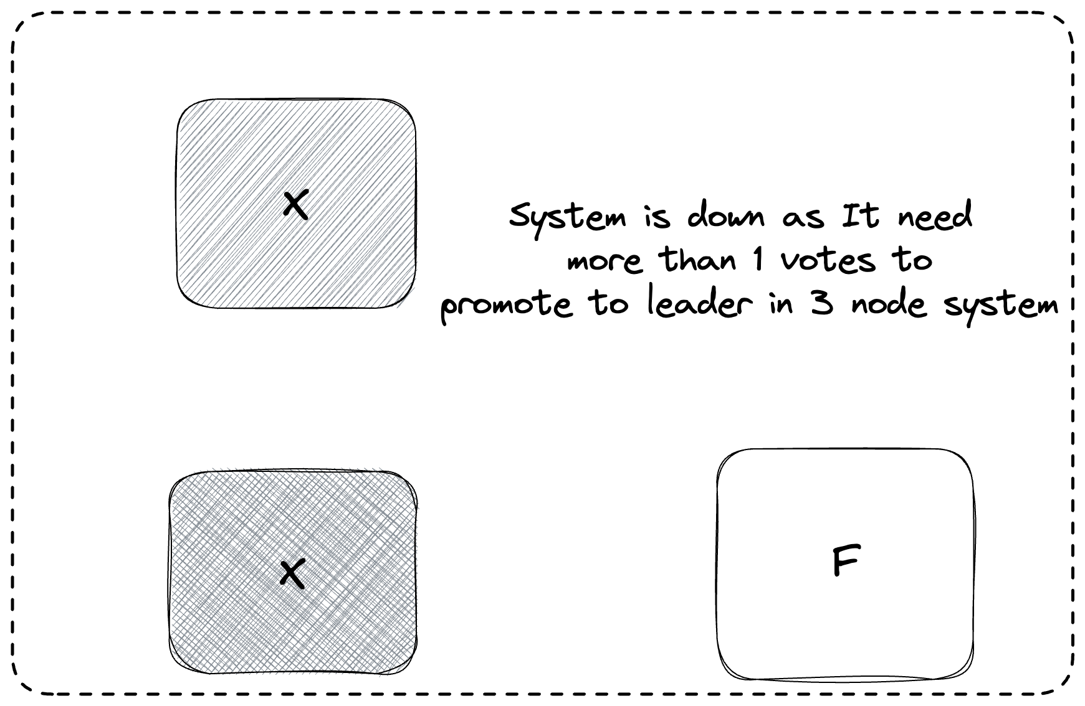

Slide 19
Leader Election (Best case scenario)
Refer diagram attached separately

Slide 20
Leader Election (Split Vote)
Refer diagram attached separately

Slide 21
Log Replication
Refer diagram attached separately

Slide 22
Log Replication (with network partitions)
Refer diagram attached separately

Slide 23
A Byzantine failure
a condition of a distributed computing systems, where components may fail and there is imperfect information on whether a component has failed.
a component such as a server can inconsistently appear both failed and functioning to failure-detection systems, presenting different symptoms to different observers.

Slide 24
etcd - A Byzantine failure is real
When cluster leader fails, etcd uses RAFT protocol to maintain consistency and establish consensus to promote a new leader.
In the RAFT protocol, cluster members are assumed to be either available or unavailable, and to provide accurate information or none at all.
This works fine when a machine crashes, but is not always able to handle situations where different members of the cluster have conflicting information.

Slide 25
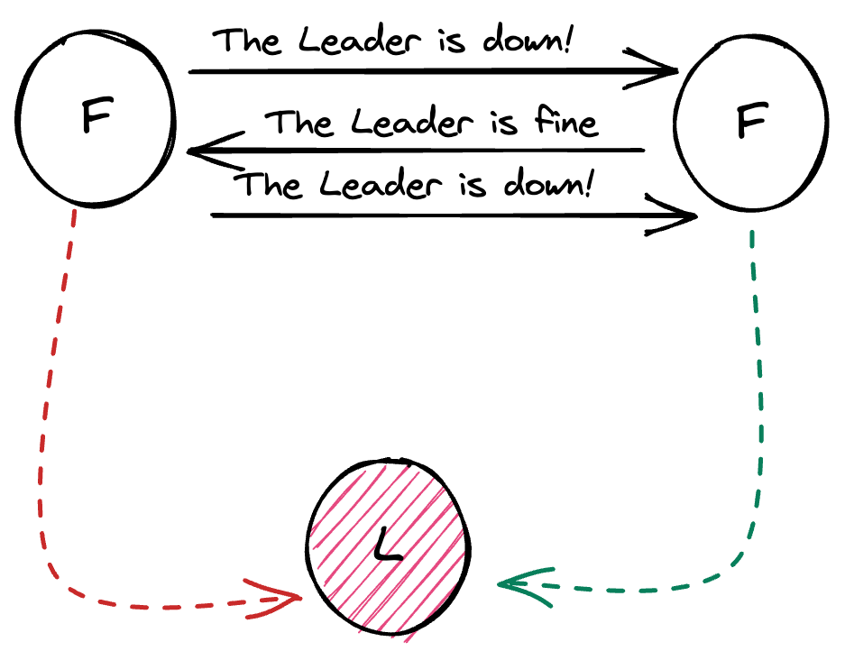
RAFT - A Byzantine failure is real
This caused cluster members to have conflicting views of reality, known in distributed systems theory as a Byzantine fault.

Slide 26

In 2020, Problem faced by

Slide 27
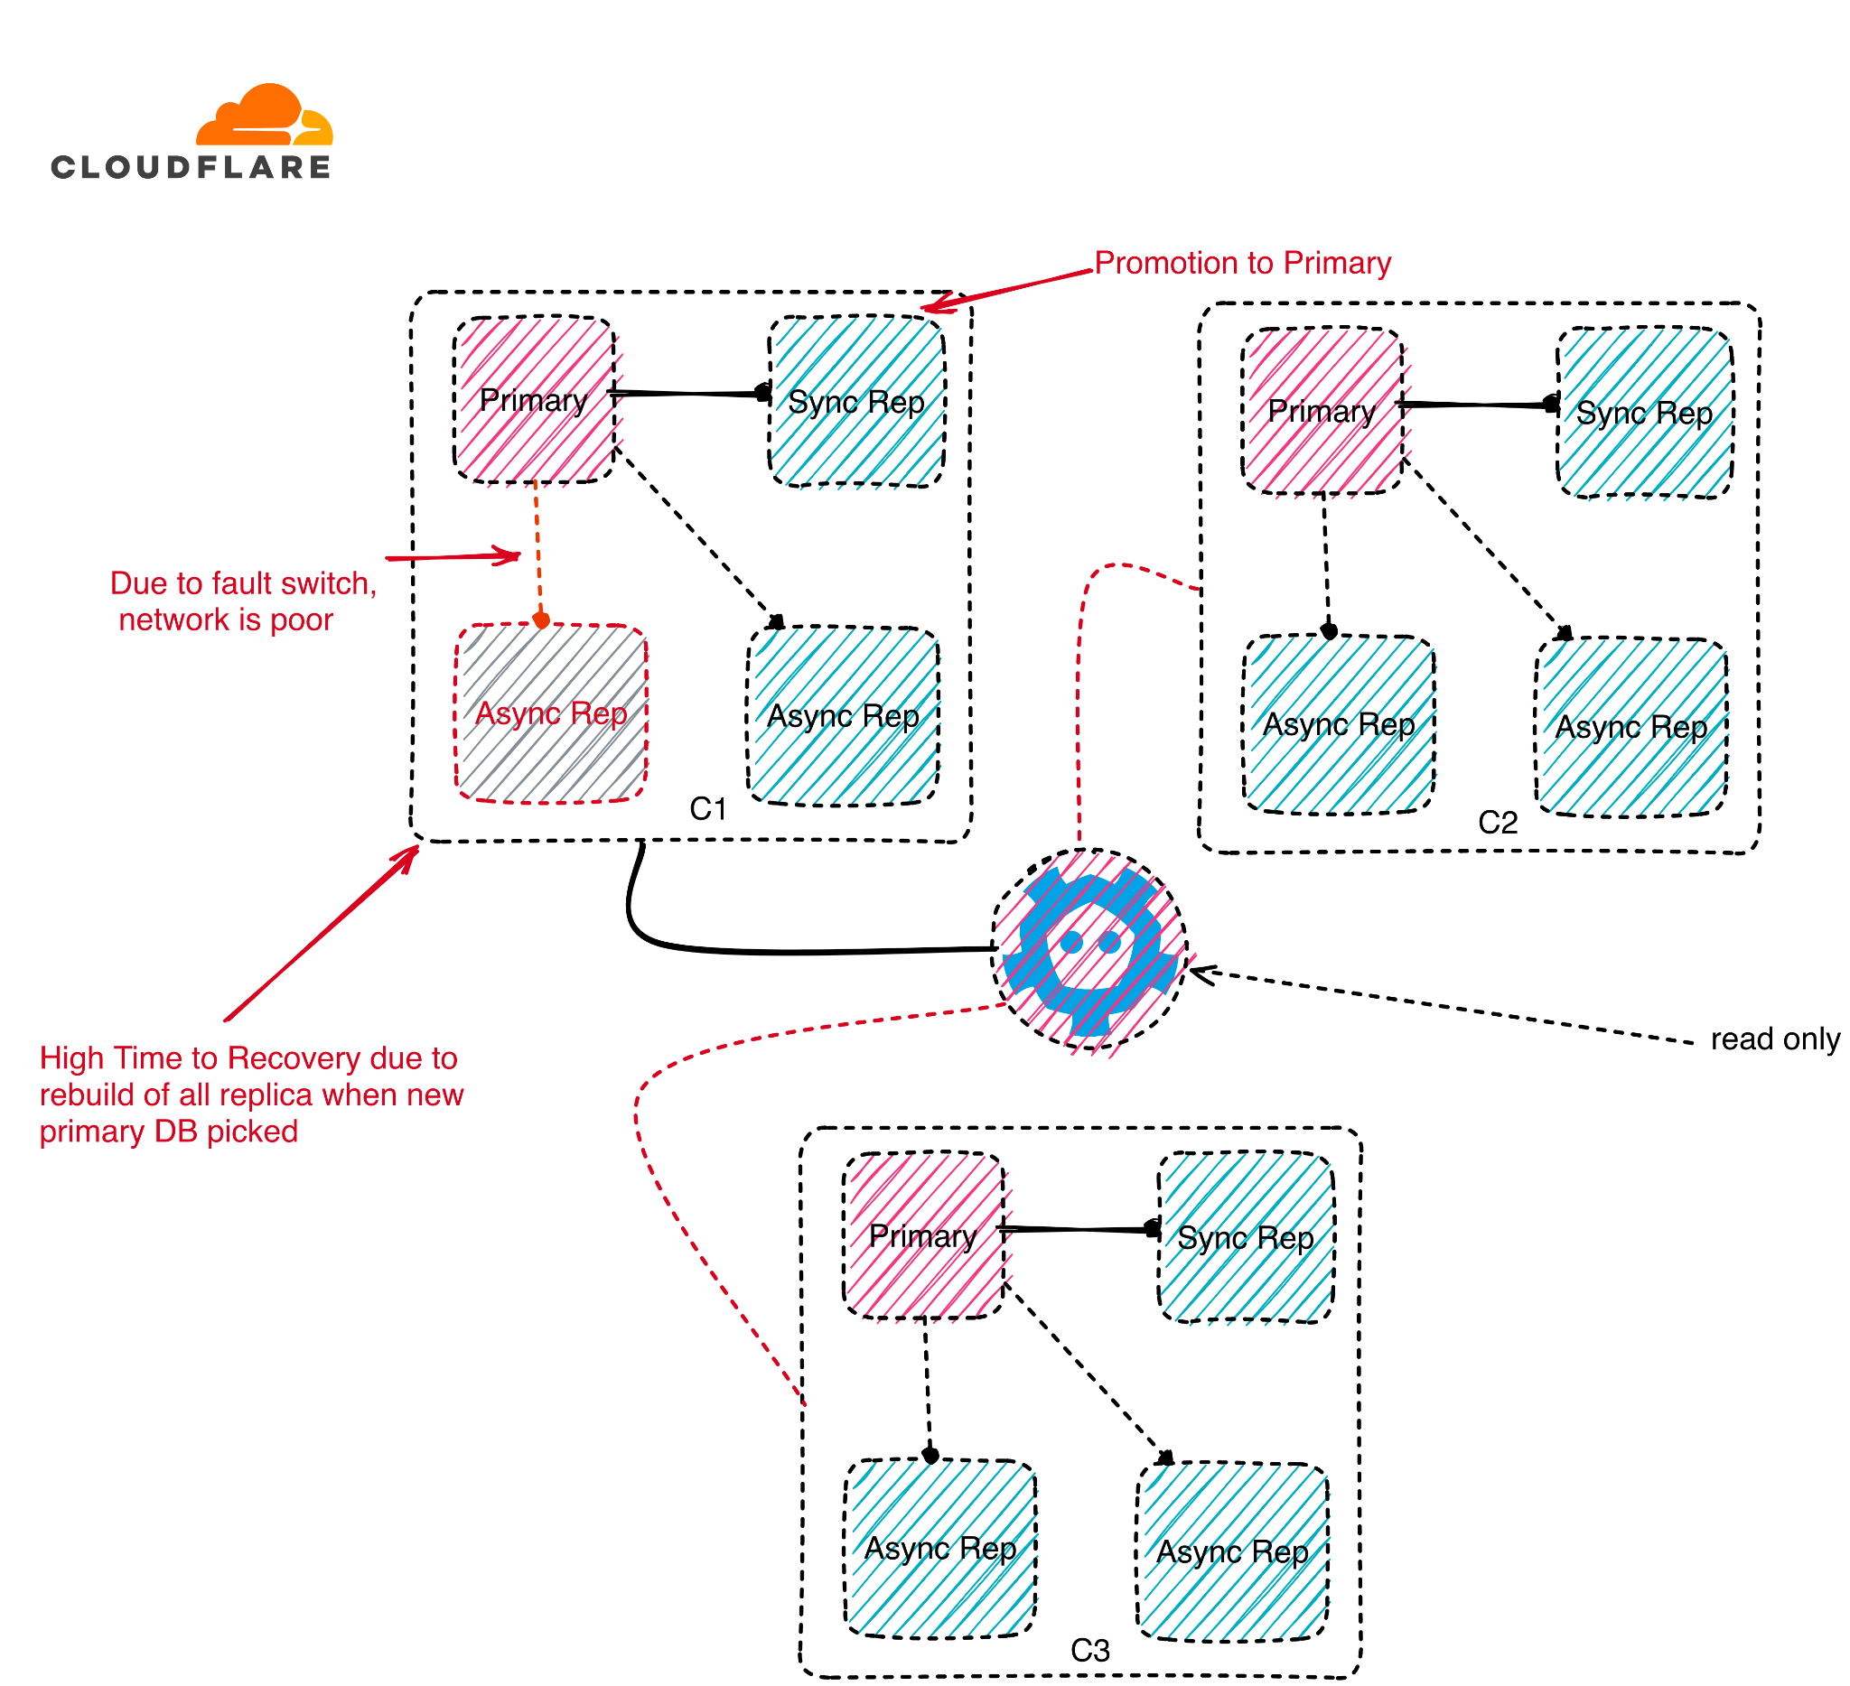

Slide 28
Impact of Byzantine failure in cloudflare
API success rate dipped to 75%.
Redundant cluster nodes were unreachable due to limbo in leader election.
Read only operation permitted to database.
More pressure to single cluster for serving traffic.
Downtime of around 6 hrs 33 min.
Dashboard api response 80 times slower compared to normal.

Slide 29














